Slide 1

Day 5
Prompting and Rag and CAG

Slide 2
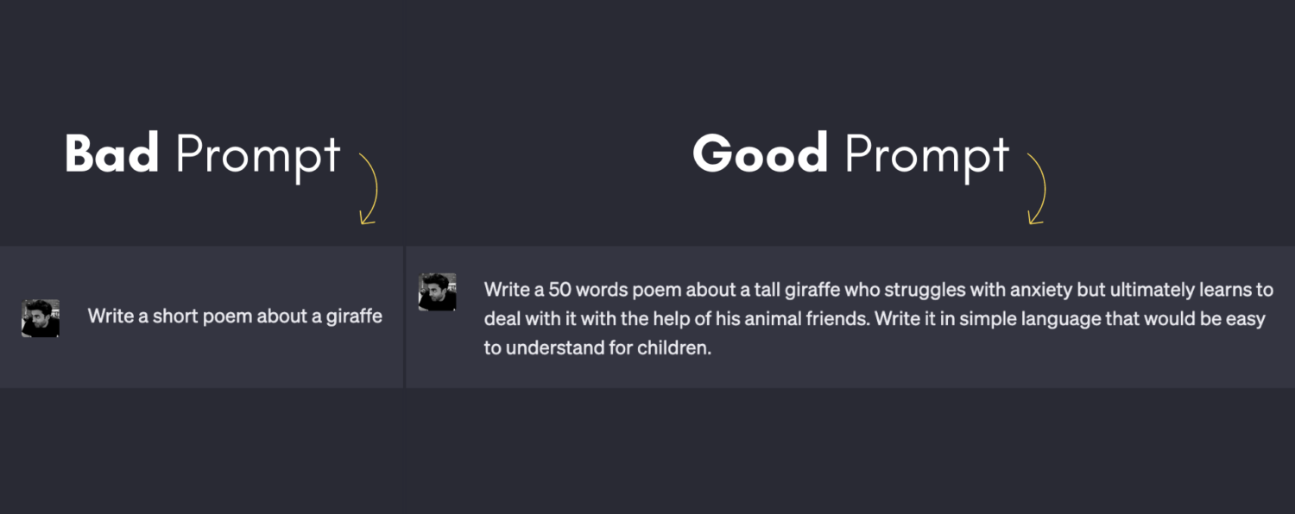
What is Prompting?
Prompting means giving clear instructions to AI so it can provide the best response. The way we write a prompt affects the quality of the answer

Slide 3
Types of Prompting (Step-by-Step with Examples)
Zero-Shot Prompting (No Example Given)
Few-Shot Prompting (Giving Examples)
Chain-of-Thought (CoT) Prompting (Step-by-Step Thinking)
Role-Based Prompting (Assigning a Role)
Instruction-Based Prompting (Giving Clear Instructions)
Multimodal Prompting (Using Text + Image/Audio)
Self-Consistency Prompting (Generating Multiple Answers)
Refinement Prompting (Improving a Previous Response)

Slide 4
Types of Prompting (Step-by-Step with Examples)
3. Chain-of-Thought (CoT) Prompting (Step-by-Step Thinking)
📝 Prompt: "Lisa has 4 chocolates. She buys 3 more and gives 2 to her friend. How many does she have now? Explain step by step.“
🤖 AI Response: "Lisa starts with 4 chocolates. She buys 3 more → Now she has 4 + 3 = 7 chocolates. She gives 2 away → Now she has 7 - 2 = 5 chocolates.` So, the answer is 5 chocolates."

Slide 5
Types of Prompting
Role-Based Prompting (Assigning a Role)📝
Prompt: "You are a history professor. Explain the French Revolution in simple words."
🤖 AI Response: "The French Revolution (1789-1799) was when people in France fought for freedom from their king. They wanted equality and democracy. The revolution changed France forever."

Slide 6
Types of Prompting
. Instruction-Based Prompting (Giving Clear Instructions)
📝 Prompt: "Summarize this paragraph in one sentence: 'The sun is the closest star to Earth. It provides light and heat, which are essential for life. Without the sun, the planet would be too cold for living beings.'"
🤖 AI Response: "The sun provides light and heat, making life possible on Earth."

Slide 7
Medium Blog
1. The Power of Vector Databases: Why They’re Essential for AI and Search
👉 Explore what vector databases are, why they matter in AI, and how they improve search and recommendation systems
2. Breaking Text into Chunks: How to Store and Retrieve Information in a Vector Database
👉 A practical guide on chunking text, converting it into embeddings, and storing it in a vector database for efficient retrieval.
3. FAISS vs. Pinecone vs. ChromaDB: Comparing the Top Vector Databases
👉 A deep dive into different vector databases, their strengths, weaknesses, and which one to use for AI and search applications.
4. From Words to Numbers: 5 Techniques to Convert Text into Vectors
👉 Explain different embedding techniques (Word2Vec, BERT, Sentence Transformers, OpenAI Embeddings) and when to use them.
5. Mastering AI Prompting: The 7 Most Powerful Prompting Techniques Explained
👉 Discuss different prompting methods (zero-shot, few-shot, CoT, role-based, self-consistency) with real-world examples.

Slide 8
Medium Blog
6. Retrieval-Augmented Generation (RAG): The Future of AI-Powered Search and Chatbots
👉 Explain what RAG is, how it works, and why it’s a game-changer for AI assistants and knowledge-based applications.
7. Context-Augmented Generation (CAG) vs. RAG: Which One is Better for AI Applications?
👉 Compare CAG and RAG, their use cases, pros & cons, and which approach is better for large-scale AI retrieval tasks.
8. Transformers Demystified: How They Power Modern AI Models like GPT and BERT
👉 A simple, step-by-step explanation of how transformers work, their role in deep learning, and why they outperform older models.
9. How to Train Video-Based AI Models: A Step-by-Step Guide
👉 Cover video classification, action recognition, and training models like SlowFast, TimeSformer, and ViViT with real datasets.
10. Fine-Tuning Image Models: How to Improve Computer Vision Accuracy
👉 Explain how to fine-tune pre-trained image models (like ResNet, ViT, EfficientNet) for better accuracy in classification and object detection tasks.

